Slide 1
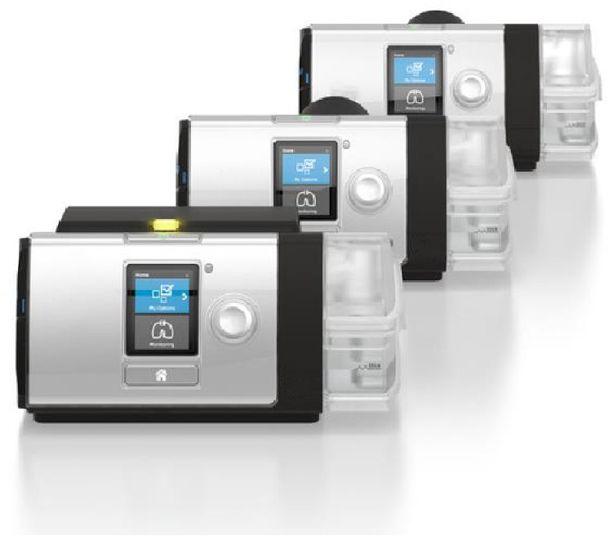
SMU
Lumis
Personalized ventilation made easy

Slide 2

Personalized ventilation made easy
Lumis is a Invasive and non invasive ventilator series designed for non- dependent patients with respiratory insufficiency.
Remote monitoring with a built-in connectivity to AirView*
Easy-to-read front facing color screen
Low-touch navigation by QuickNav
Ramp and Ramp Down for extra comfort
Detail assessment with high resolution data
using SD card and ResScan
Automatic humidification ‘Climate Control Auto’
Volume assurance iVAPS mode with optional AutoEPAP
An optional Intelligent backup breath
Easy to setup and use,
Lumis ventilator feature Our technologies that enable therapy to be tailored to individual breathing
needs - making personalized ventilation easy
* Devices with wireless communication might not be available in all regions.

Slide 3
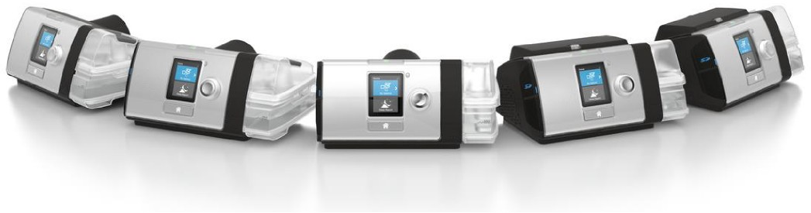

Lumis series product comparison
_{Features} Lumis 150 VPAP ST
Indication for use | 13 kg or more, 30 kg or more for iVAPS
Modes | CPAP, S, ST (optional iBR), T, PAC
iVAPS mode (optional AutoEPAP)
Pressure | 2– 30 cmH₂O
Alarms

Slide 4
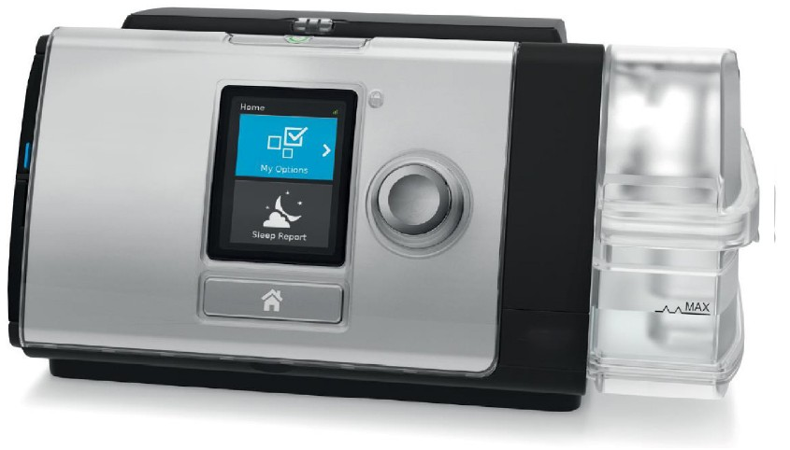
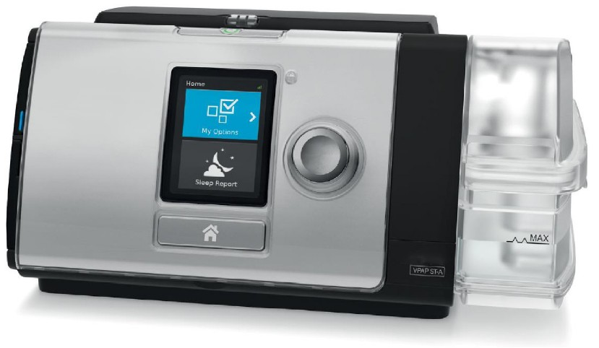
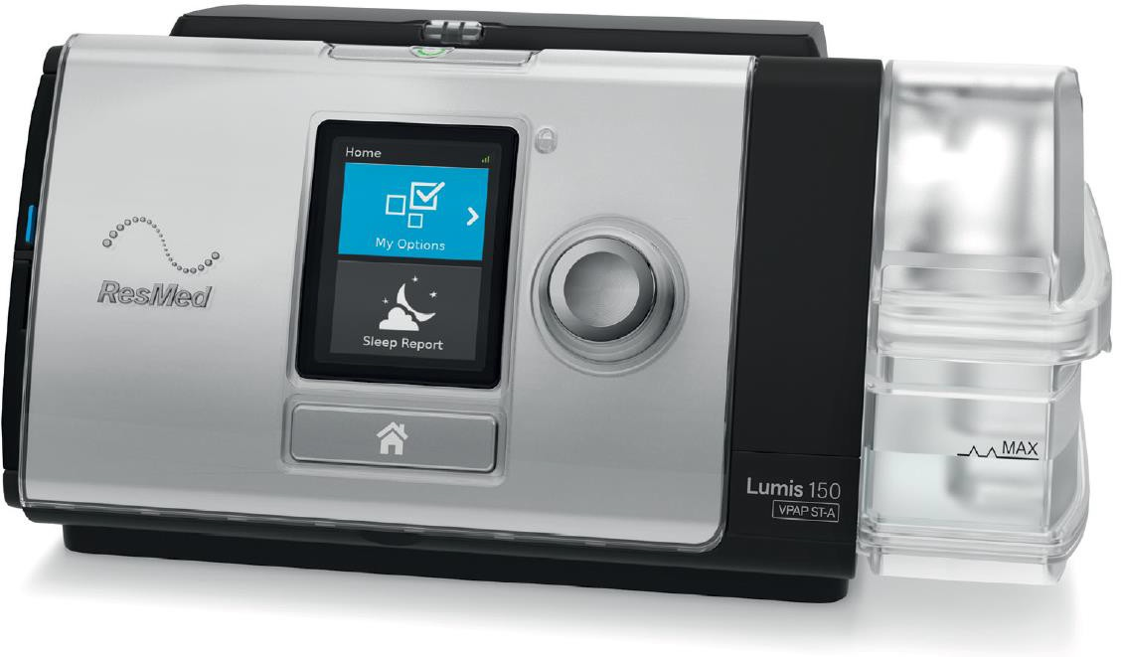

Lumis at a glance
LED Alarms indicator for extra assurance
Built-in connectivity to AirView and MyAir*
Light sensor for screen brightness
Start/Stop button
Inserted SD card for assessment and settings change
Integrated HumidAir
heated humidifier
Optional oximetry module and oximeter
Small foot print
1,2kg (with HumidAir)
QuickNav and optional Therapy LED
Push-dial navigation and
press to mute alarms
*Devices with wireless communication might not be available in all regions.

Slide 5
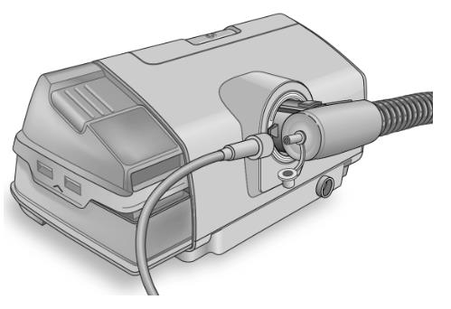
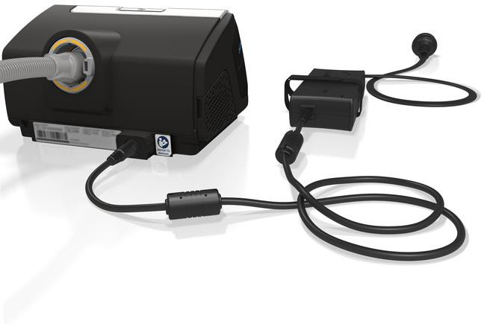
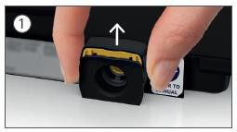
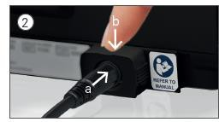
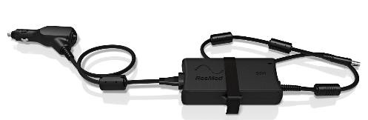
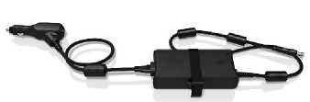

Rear view
When used with ClimateLineAir™ (15 mm) or ClimateLineAir Oxy (19 mm),
‘auto’ humidity setting maintains the set temperature and relative humidity automatically.
ClimateLineAir Oxy has an oxygen connector port.
Lumis can be powered by an external battery Power Station II or car/boat with a suitable battery via Air10 DC/DC converter.
Power cord retention clip
Standard or hypoallergenic air filters
(common with S9 series)

Slide 6
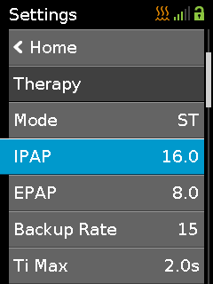
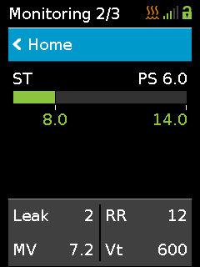

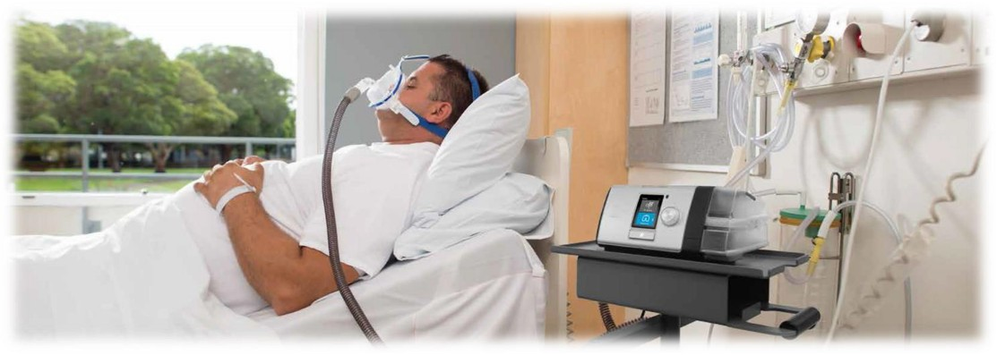
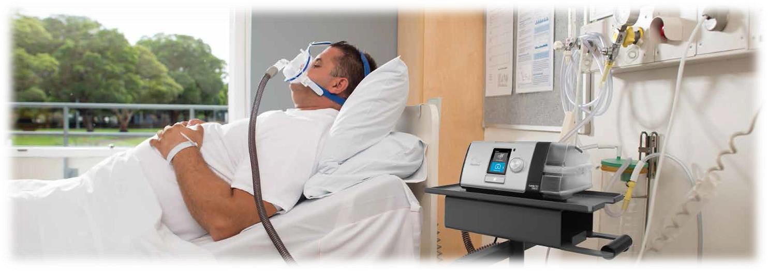

Easy menu navigation and QuickView
Linear menu structure and the push dial – it is intuitive and simple to navigate.
By double-clicking home button, QuickNav feature provides a toggle between the Settings and Monitoring screens.
It helps to adjust secondary settings that impact patient comfort – check Trigger/Cycle effort, inspiratory time, etc.

Slide 7
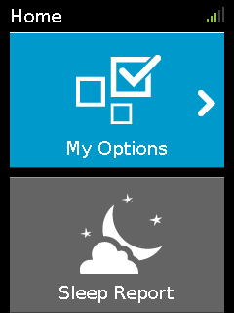
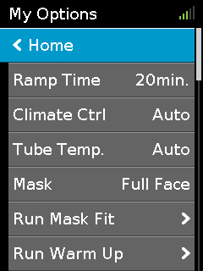
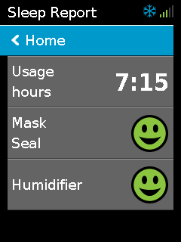



Patient menus
In the patient menu, there are two sub-menus: My Options and Sleep Report.
Home Menu
My Options Patients can make small adjustments.
Sleep Report
After stopping therapy, patients
can check therapy data.
Essentials Plus
If set by clinician, patient can adjust more settings (eg. mask type, Ramp Down, SmartStart).
Essentials Plus If set by clinician, patient can view:
Events per hour,
More Info (eg. Leak, MV)
Clinician can choose patient access to therapy settings and data;
Essentials and E. ssentials Plus

Slide 8

Modes of Ventilation
Lumis operates with a single open (leak) circuit, and all modes are pressure based.
o CPAP mode
o S (Spontaneous) or PS (Pressure Support)
o ST (Spontaneous/Timed) or PS (Pressure Support with backup rate)
o T (Timed) or Pressure controlled
o PAC (Pressure Assist Control)
o iVAPS (intelligent Volume Assured Pressure Support)

